Slide 1
Affects of Interest rates
Jarrod Williams, Bill Smith, Marc Conwell

Slide 2
INTRODUCTION
Question 1: Is there a liner relationship between short-term interest rates and long-term interest rates?
Question 2: Is there a liner relationship between short-term interest rates and change in S&P500?
Question 3: Is there a liner relationship between sunspot activity and short-term interest rates?

Slide 3
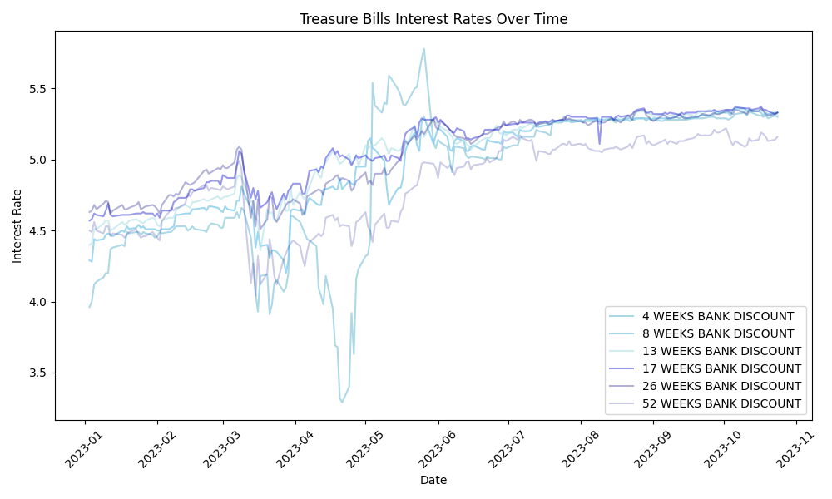
AREAS OF GROWTH

Slide 4
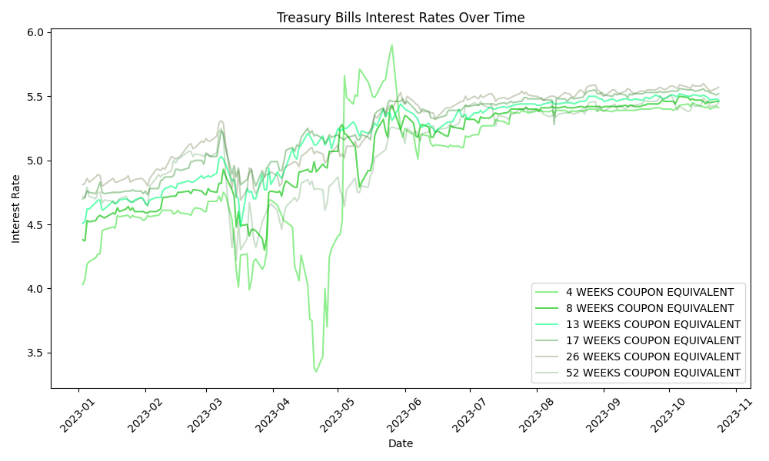

Slide 5
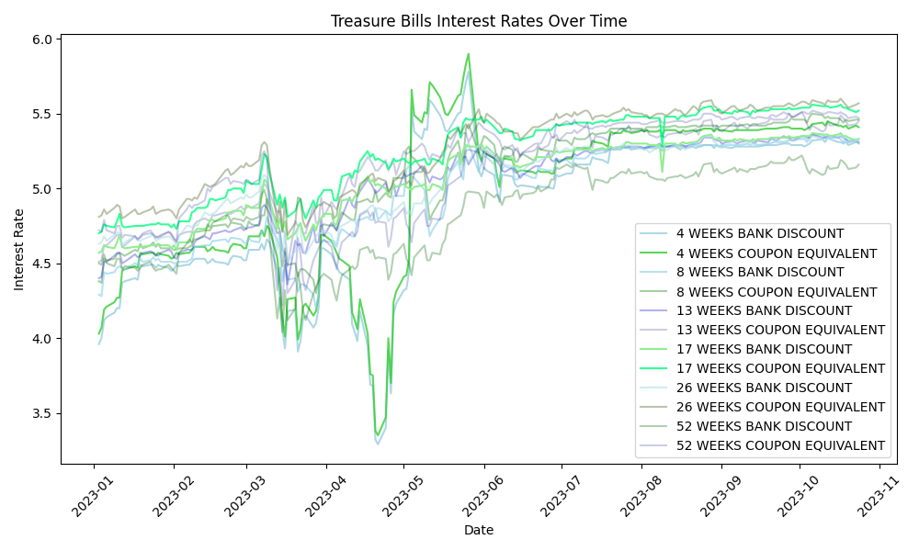

Slide 6
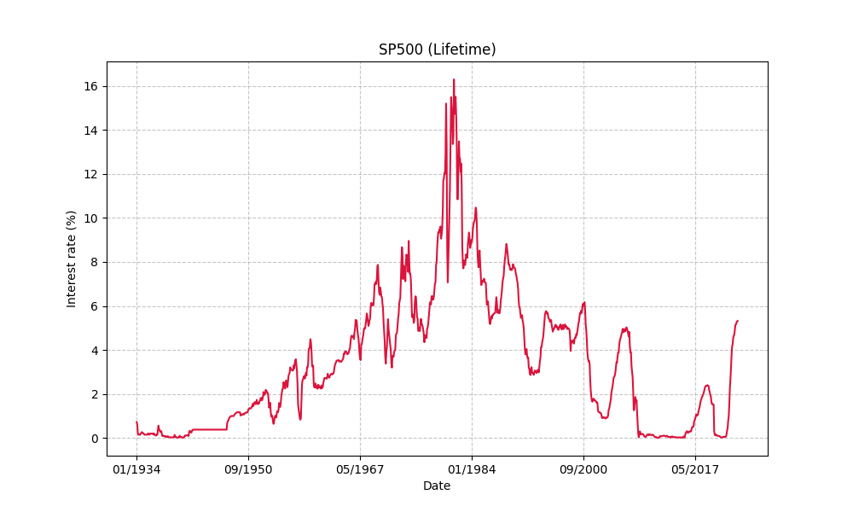

Slide 7
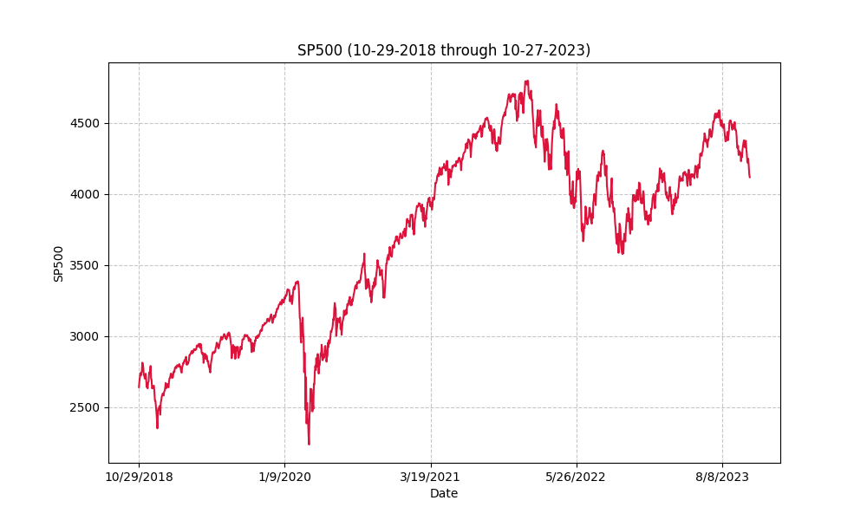

Slide 8
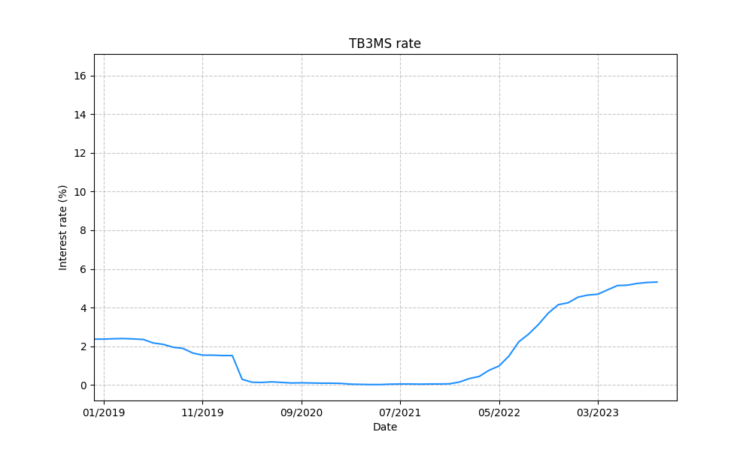

Slide 9
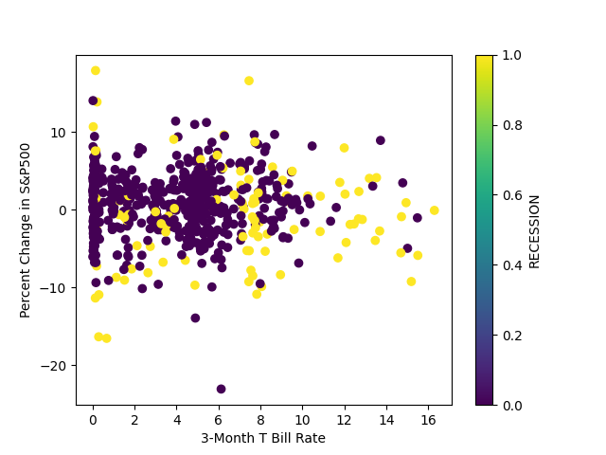
Short term interest VS SP500

Slide 10
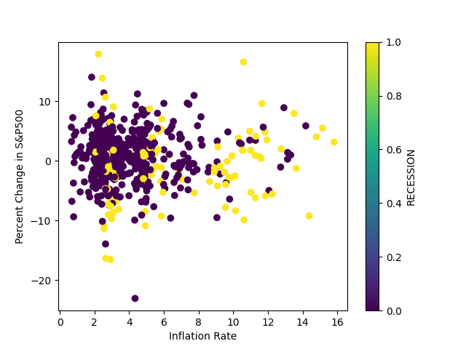
Inflation vs. SP500

Slide 11
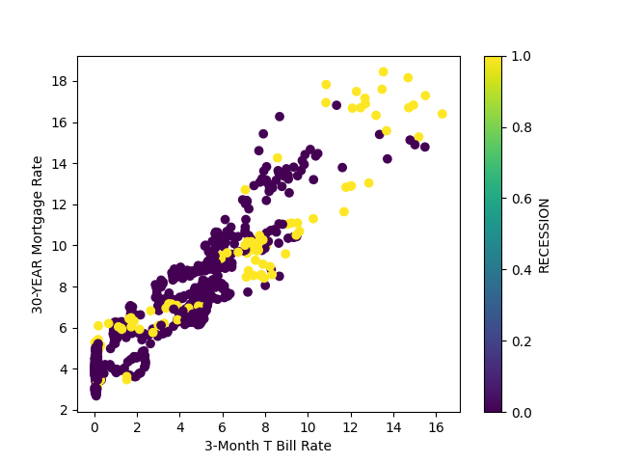
Short term interest VS long term interest

Slide 12
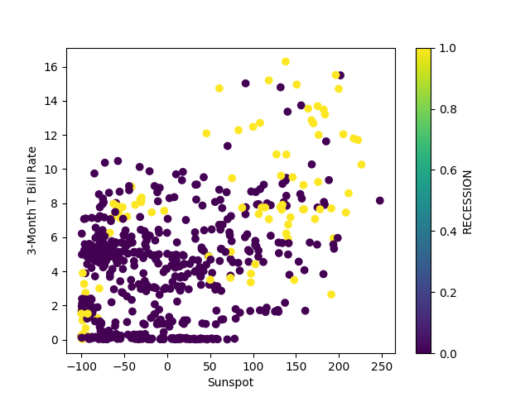
Sunspot vs short term interest rate

Slide 13
Conclusion to question 1
Question 1: Is there a liner relationship between short-term interest rates and long-term interest rates?
Random Variable X = TB3MS = 3-month treasury bill interest rate
Random Variable Y = 30YEAR = home mortgage interest rates on a 30-year fixed mortgage
ASSUME: There is no linear relationship between random variables X and Y
• Null Hypothesis, H₀ : ρ = 0
• Alternate Hypothesis, H₁ : ρ ≠ 0
Correlation Coefficient (X , Y) = ρ = 0.929872
T-test statistic = ρ [(n-2 )/(1 – ρ ^ 2)] ^ ½ = 0.93 [ 628 / (1 – 0.93 ^2)] ^ ½ = 23.3
2-tail test with α = 0.05 ; n = 630 ; 2 degrees freedom → critical value t-dist = 1.964
Conclusion:
• Conclusion: We reject null hypothesis.
• Data is consistent with linear relation between long term and short-term interest rates.
• This is exactly what we would expect because interest rates tend to move together.

Slide 14
Conclusion to question 2
Question 2: Is there a liner relationship between short-term interest rates and change in S&P500?
Random Variable X = TB3MS = 3-month treasury bill interest rate
Random Variable Y = SP500 = Percent change in SP Index over the month
ASSUME: There is no linear relationship between random variables X and Y
• Null Hypothesis, H₀ : ρ = 0
• Alternate Hypothesis, H₁ : ρ ≠ 0
Correlation Coefficient (X , Y) = ρ = -0.02
T-test statistic = ρ [(n-2 )/(1 – ρ ^ 2)] ^ ½ = -0.02 [ 628 / (1 – (-0.02 ^2))] ^ ½ = -0.52
2-tail test with α = 0.05 ; n = 630 ; 2 degrees freedom → critical value t-dist = 1.964
[ T-test statistic = | -0.52| ] < [Critical value = 1.964 ] → WE ACCEPT NULL HYPOTHESIS
Conclusion
• Conclusion: We can not reject null hypothesis.
• Data is consistent with NO linear relation btwn short-term interest rates and ∆ SP500.
• This was kind of surprising because people say interest rates strongly impact stock market.
• Dig deeper and it’s CHANGE in EXPECTIONS for future interest rates that drive stock market
• Presumably we’d have strong linear relationship with expected future change in interest rates.

Slide 15
Conclusion to question 3
Question 3: Is there a liner relationship between sunspot activity and short-term interest rates?
Random Variable X = SUNSPOTS = Percent change in sunspots compared to historical average Random Variable Y = TB3MS = 3-month treasury bill interest rate
ASSUME: There is no linear relationship between random variables X and Y
• Null Hypothesis, H₀ : ρ = 0
• Alternate Hypothesis, H₁ : ρ ≠ 0
Correlation Coefficient (X , Y) = ρ = 0.44
T-test statistic = ρ [(n-2 )/(1 – ρ ^ 2)] ^ ½ = -0.02 [ 628 / (1 – 0.44 ^2)] ^ ½ = 12.4
2-tail test with α = 0.05 ; n = 630 ; 2 degrees freedom → critical value t-dist = 1.964
[ T-test statistic = 12.4 ] > [Critical value = 1.964 ] → WE REJECT NULL HYPOTHESIS
Conclusion
• Conclusion: We reject null hypothesis.
• SUNSPOTS CORRELATE To INTEREST RATES !!!
• Awesome example of limitations of looking to correlation matrix for significance.

Slide 16
THANK YOU

